Slide 1
Observations
Application is in bad shape
  Confirmed by several Wily experts
Slowness manifests itself in many ways
  JDBC Connections maxed out
  Threads maxed out
  JVM pegs
  MQ slow response time
  DB slow response time
  XML processing time
  900+ second Servlet calls
  etc…
Heap not set correctly – tuning required
Database – death by a thousand cuts
Application tightly coupled to MQ
JDBC errors
JavaMail errors
And many more …

Slide 2
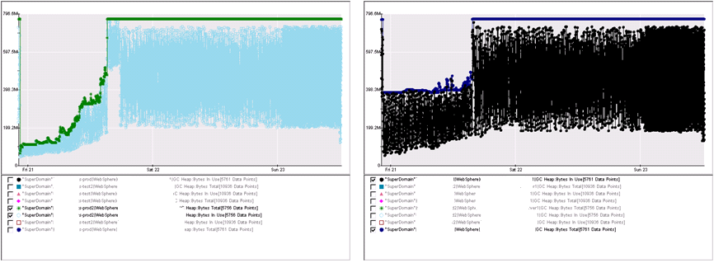
Prod Heap is not correctly set

Slide 3
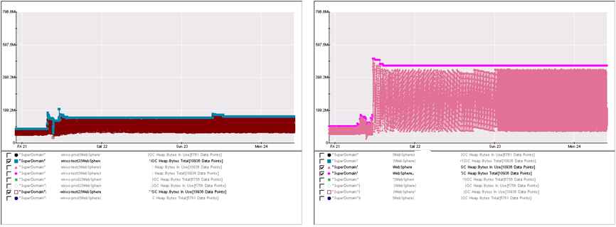
Same for QA

Slide 4
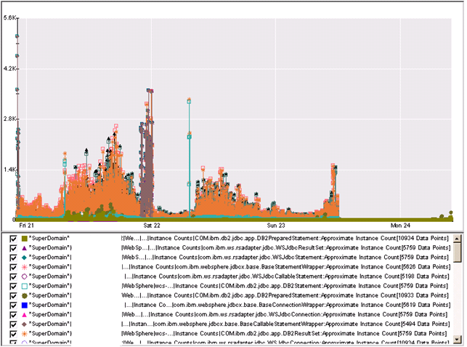
Instance Counts seem OK

Slide 5
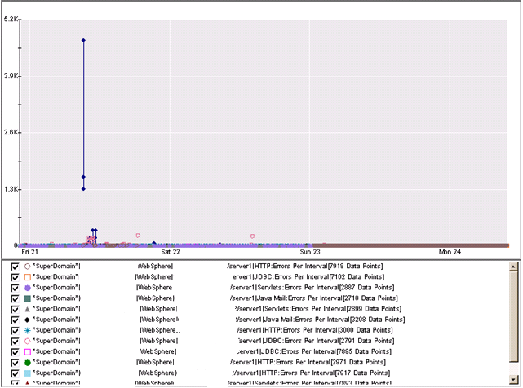
Errors Per Interval
JDBC: prod – server1

Slide 6
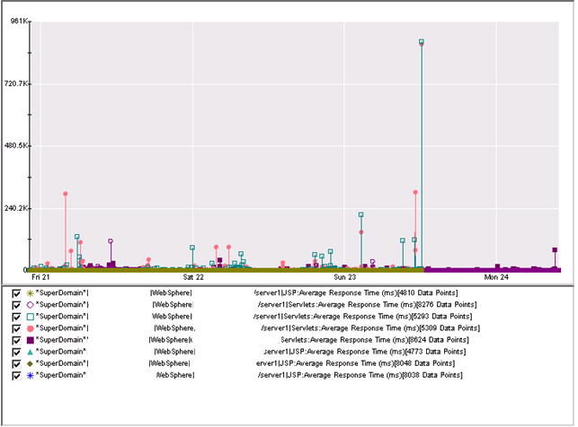
Response Times are Poor

Slide 7
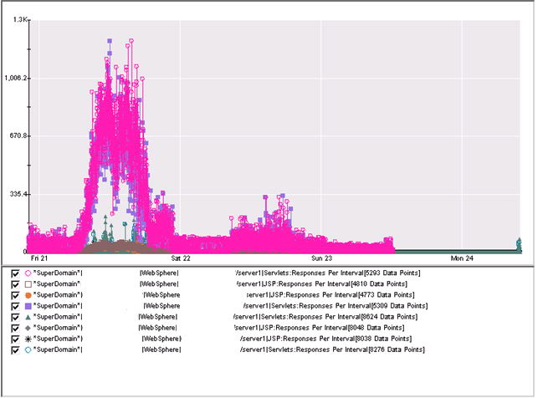
Servlet Invocations are High
Servlets
JSPs

Slide 8
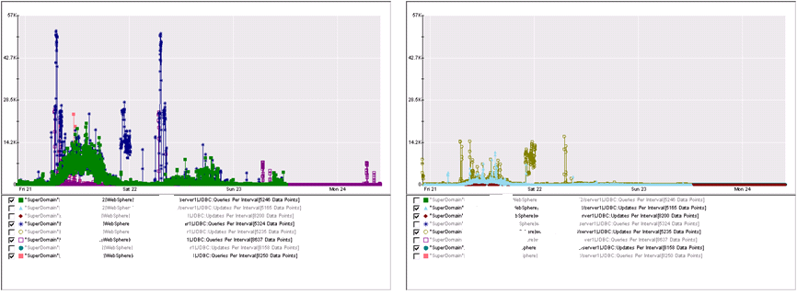
JDBC Queries Per Interval are High
Queries
Updates

Slide 9
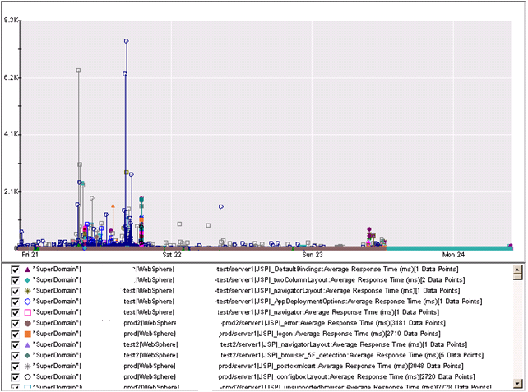
JSP Response Times are Poor

Slide 10
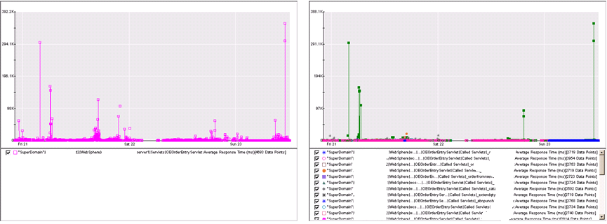
OEOrderEntryServlet is quite poor
Servlet: _catalogresults is why

Slide 11
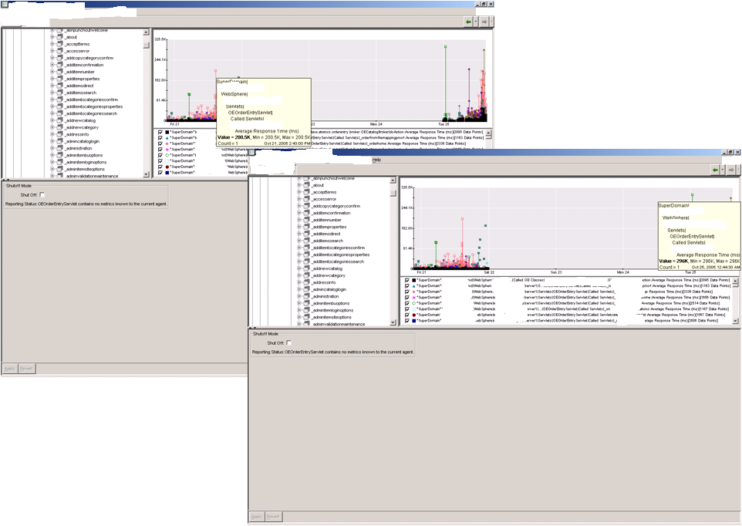
OEOrderEntryServlet calls _catalogresults method is a good place to start-300 secs!

Slide 12
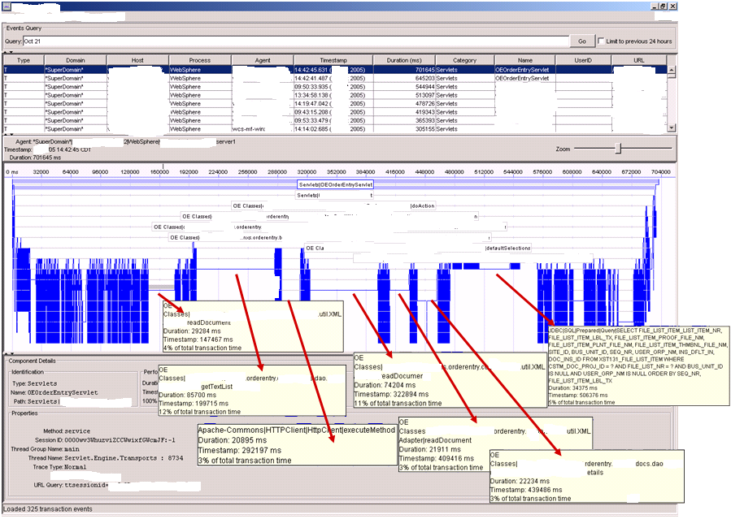
OEOrderEntryServlet: some other places to start to make incremental changes …
Here we have 300+ seconds of XML, HTTP, and SQL!!!

Slide 13
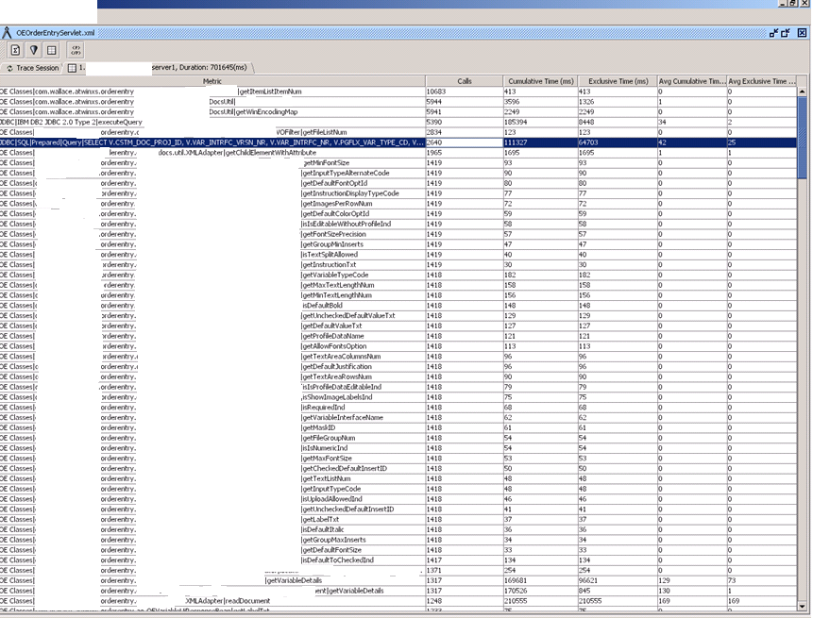
OEOrderEntryServlet … Do you really need to make 2640 SELECTS totaling 65 seconds for this transaction?

Slide 14
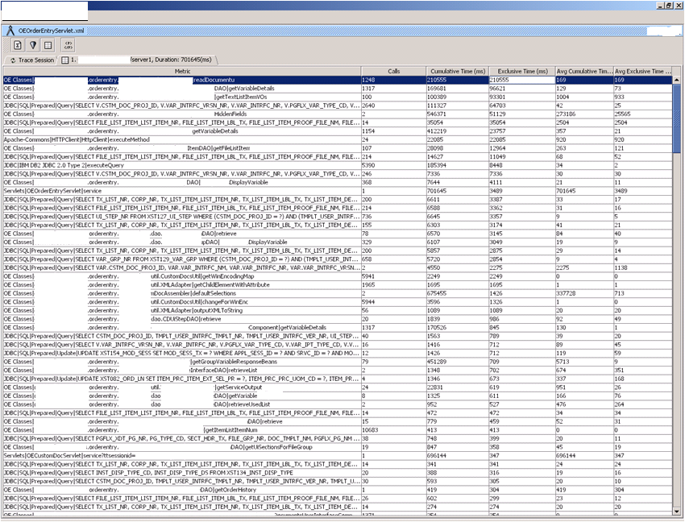
OEOrderEntryServlet … 210+ seconds in the XMLAdapter … consider offloading XML processing to another machine…

Slide 15
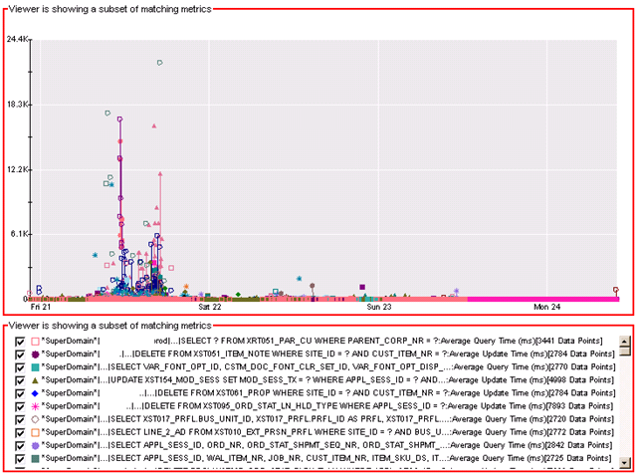
SQL Activity on Friday is Quite Poor

Slide 16
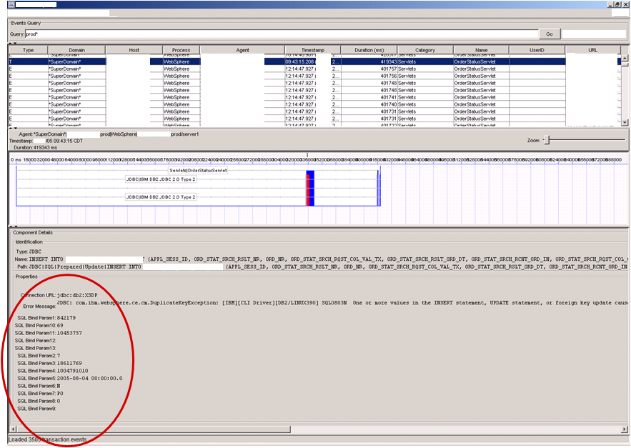
SQL Bind Parameters

Slide 17
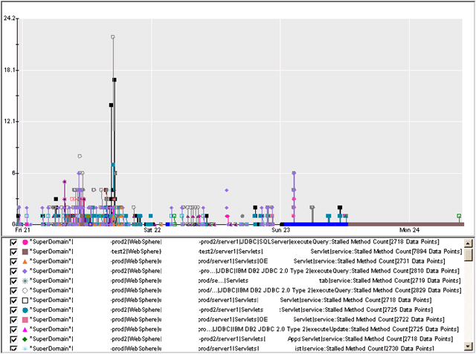
Stalls Suggest App Quality is Very Poor

Slide 18
Recommendations
There was a JDBC/SQL problem on Friday, which seems to be addressed at some level.
  Evident in SQL/JDBC Metrics, Errors Per Interval, etc.
  Response times remain very poor.
  JDBC Queries are very high suggesting a weak data model.
App quality is quite poor (high stalls) and is unsuitable as an interactive web app.
App Architecture (Servlet-based) needs to be re-factored.
_catalogresults servlet is quite poor and should be fixed first.
No apparent memory leaks. Instance Counts were unremarkable.
STOP looking for the needle in a stack of needles!
BE PROACTIVE: Start to make incremental changes to the application and gradually improve the quality, stability, and response time of the application.

Slide 19
More Details …

Slide 20
SQL Abuse

Slide 21
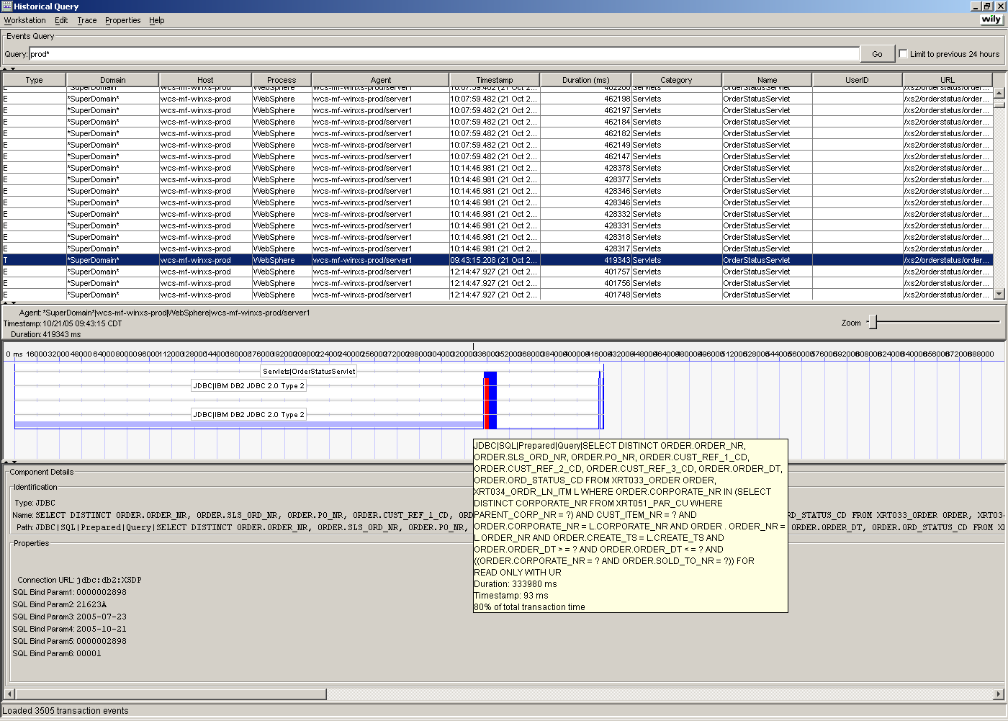
Here we have the OrderStatusServlet taking 333+ seconds … computational BLISS!
That’s what I call “SEE_CRAWL” …

Slide 22
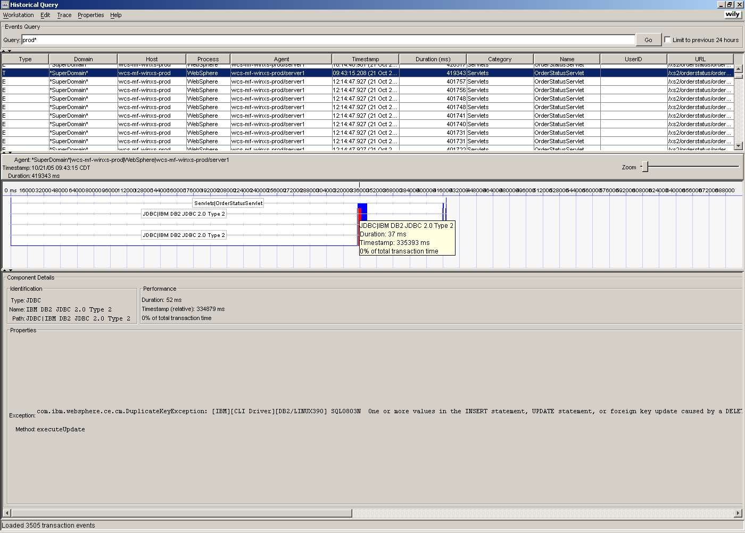
OrderStatusServlet again … Introscope’s Error Detector show a SQL exception in RED.

Slide 23
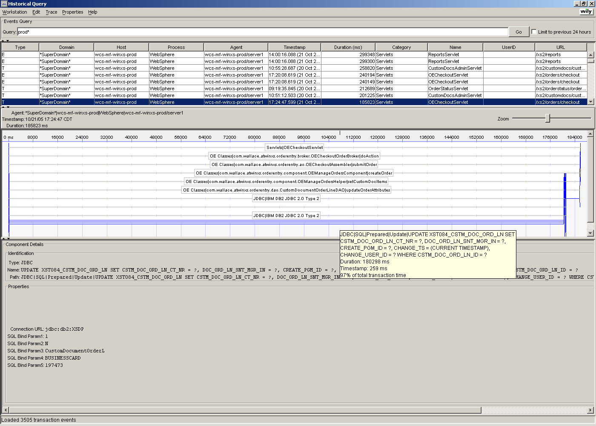
Here we have the OECheckoutServlet taking 185+ seconds!!! Somebody has to care about the 180 second SQL call ☺ … that’s just slow, I do not care who you are …

Slide 24
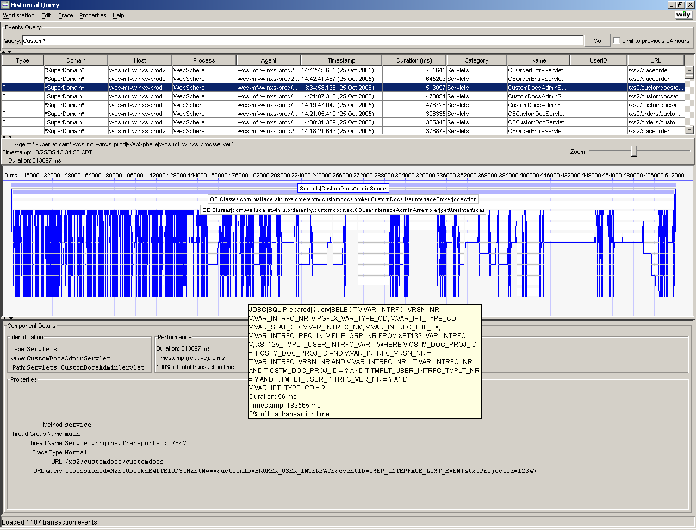
Here is a classic case of “death by a thousands cuts” … Hey, the database response time is fine! However, the application code, CustomDocsAdminServlet, is abusing a precious resource…for about 500 seconds!

Slide 25
MQ

Slide 26
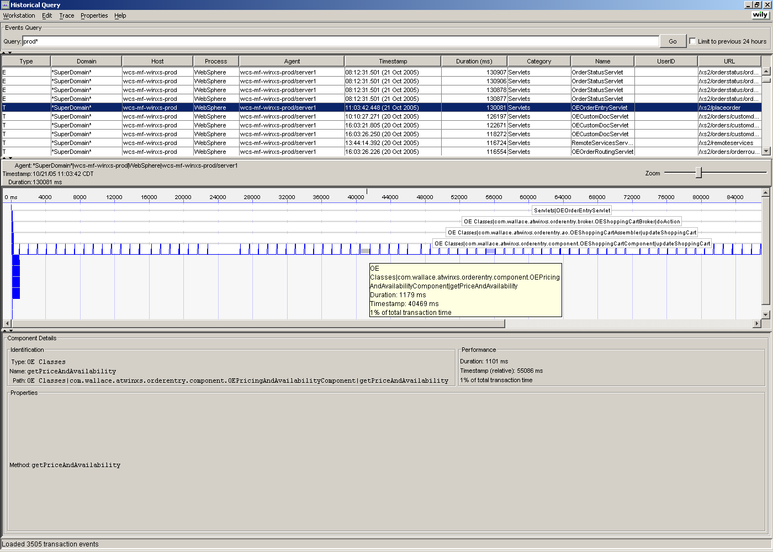
Looping through each item in the shopping cart and checking price and availability. Each of these price checks is a call to MQ (1 second per call). This OrderEntryServlet is 130+ seconds.

Slide 27
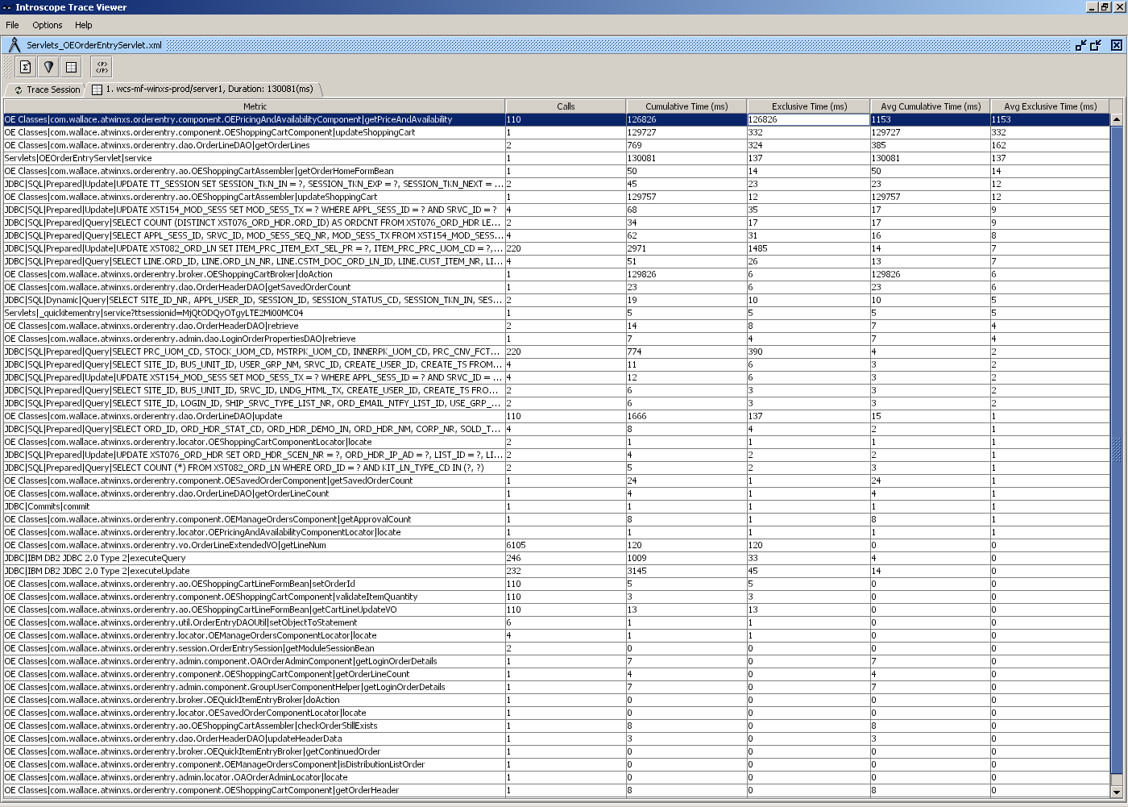
OrderEntryServlet in TraceViewer shows 110 calls to getPriceAndAvailability() … totaling 126+ seconds. Start here …

Slide 28
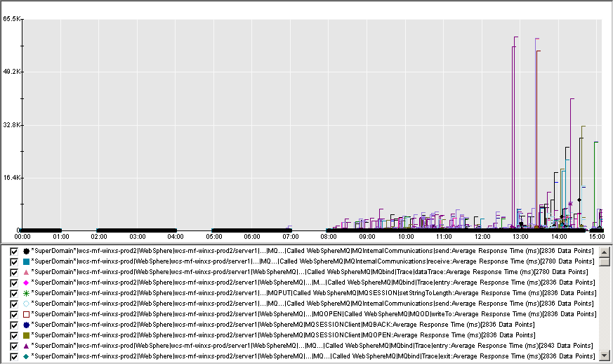
Even if you shopping cart is 3 to 4 items on average, MQPUT() and MQGET() calls around 60 seconds will leave your customers hanging … just trying to check out.
“Hey can you spare a minute?”
Here we added the MQ Powerpack …

Slide 29
Using Introscope to
Observe Application Behavior

Slide 30
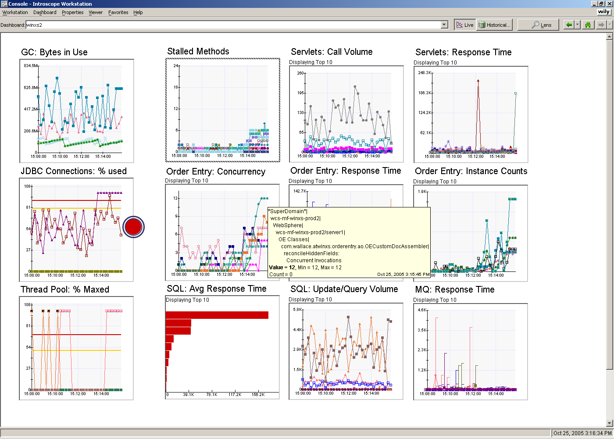
Patterns: JDBC connections and threads maxing out … OECustomDocAssembler.reconcileHiddenFields() concurrency would rise as well…

Slide 31
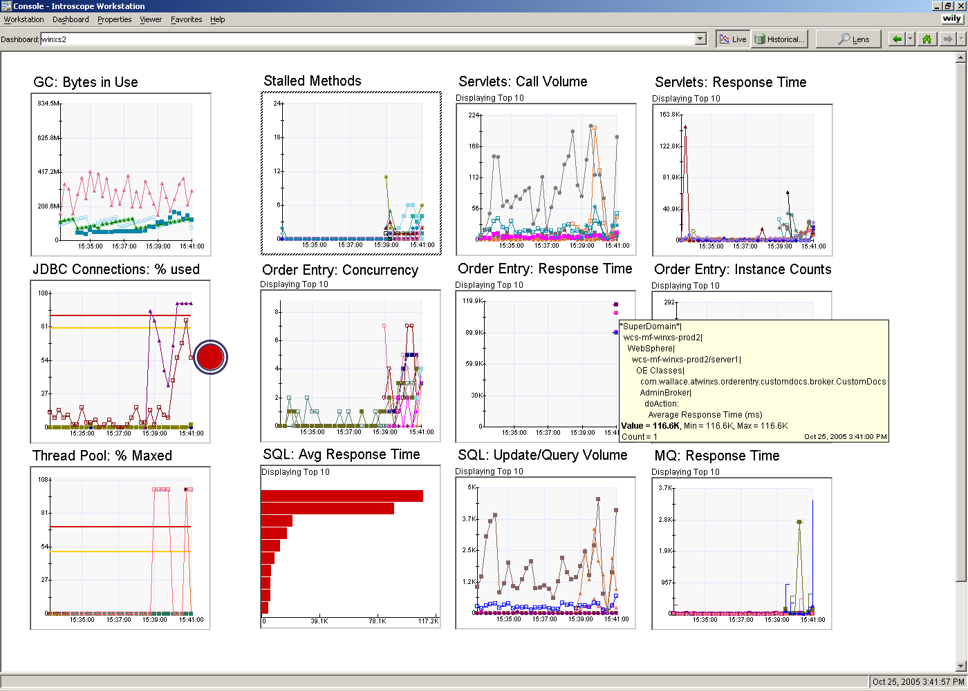
Patterns: Then we would see a long running servlet end, CustomDocsAdminBroker in this case at 116 Seconds … and the threads and connections would start to drop…

Slide 32
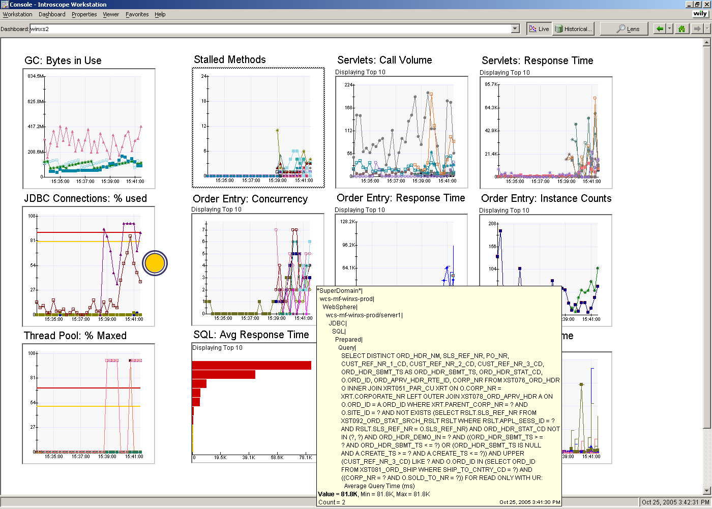
Patterns: And there was usually a nice long-running SQL statement to go with it …
81 second SQL call …

Slide 33
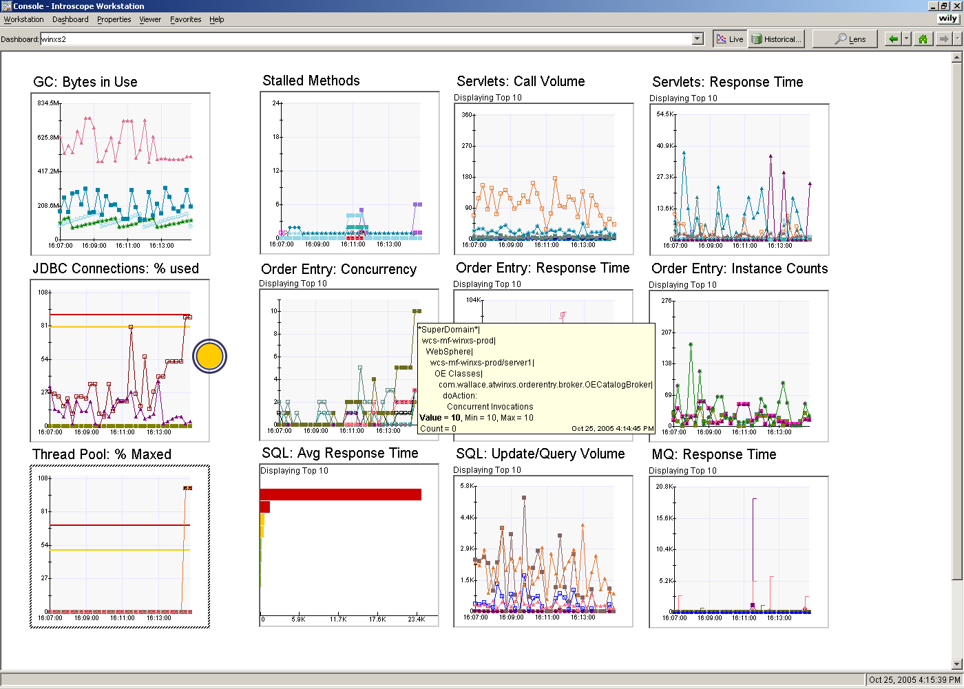
Patterns: High Concurrency on OECatalogBroker … notice the JDBC connections and threads again …

Slide 34
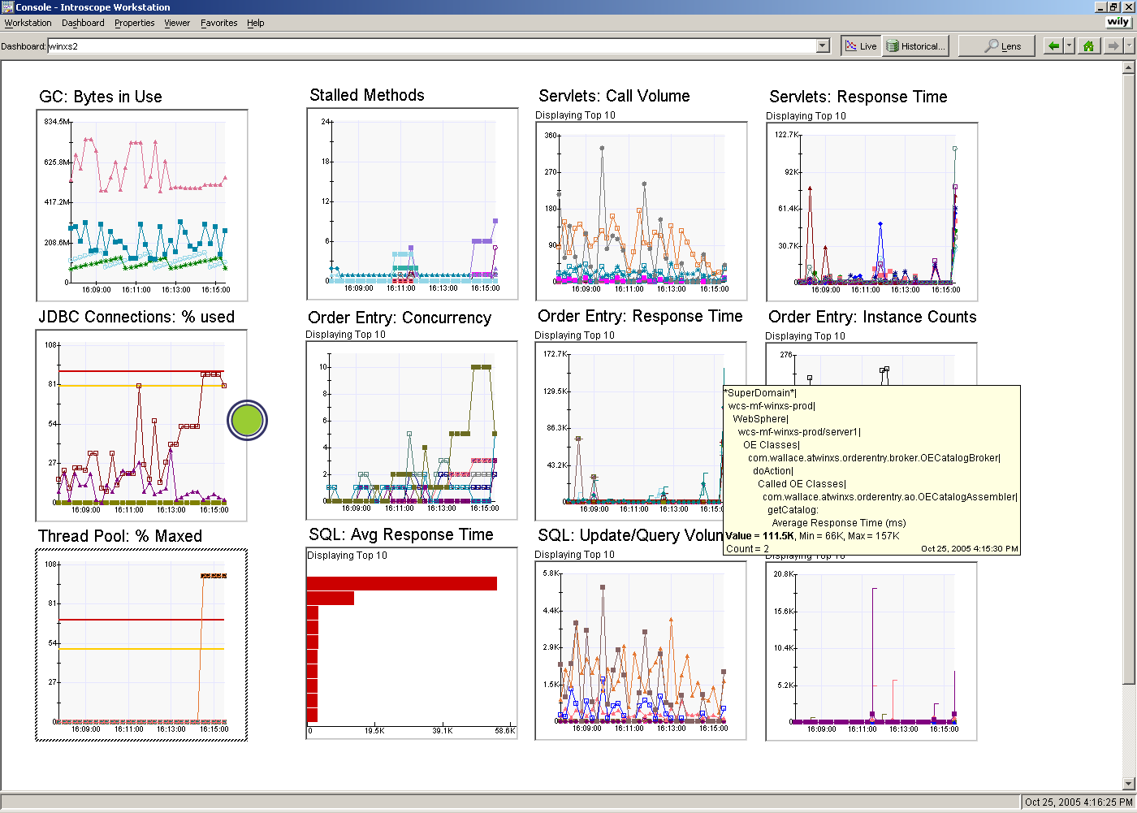
Patterns: Again, a long running servlet ends … OECatalogBroker.doaction() calls OECatalogAssembler.getcatalog() … 157 seconds for the getcatalog() method!!!

Slide 35
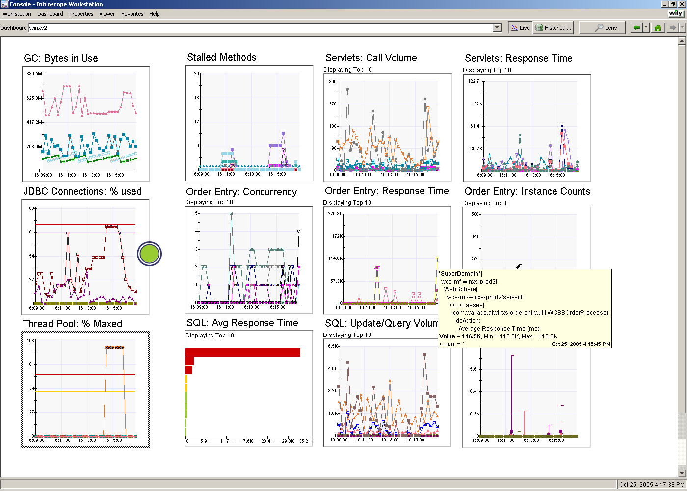
Patterns: And yet another, a long running servlet ends … WCSSOrderProcessor finishes at 116+ Seconds … notice the drop in JDBC connections and threads…

Slide 36
Where do we start?
Be Proactive
_catalogresults servlet - 300 seconds
OEOrderEntry Servlet - nearly 1000 seconds
  Tune Database calls – 35+ seconds
  Optimize SQL usage – look for caching opportunities
  Examine XML processing – 130+ seconds
  Examine HttpClient request – 20+ seconds
  Refactor getTextListItemVOs() – 85+ seconds
  Refactor getVariableDetails() – 22+ seconds
OECheckoutServlet
  Tune Database calls – 185+ seconds
CustomDocsAdminServlet
  Optimize SQL usage – look for caching opportunities
OECustomDocAssembler.reconcileHiddenFields()
OECatalogBroker calls to OECatalogAssembler.getcatalog() – 157 seconds
WCSSOrderProcessor – 116+ seconds
CustomDocsAdminBroker – always seems to be running during slow downs
MQ
  Decouple the application from MQ or minimize the number of MQ calls needed for a particular user operation.

